Slide 1

IBM Carbon TreeView
Example 01

Slide 2
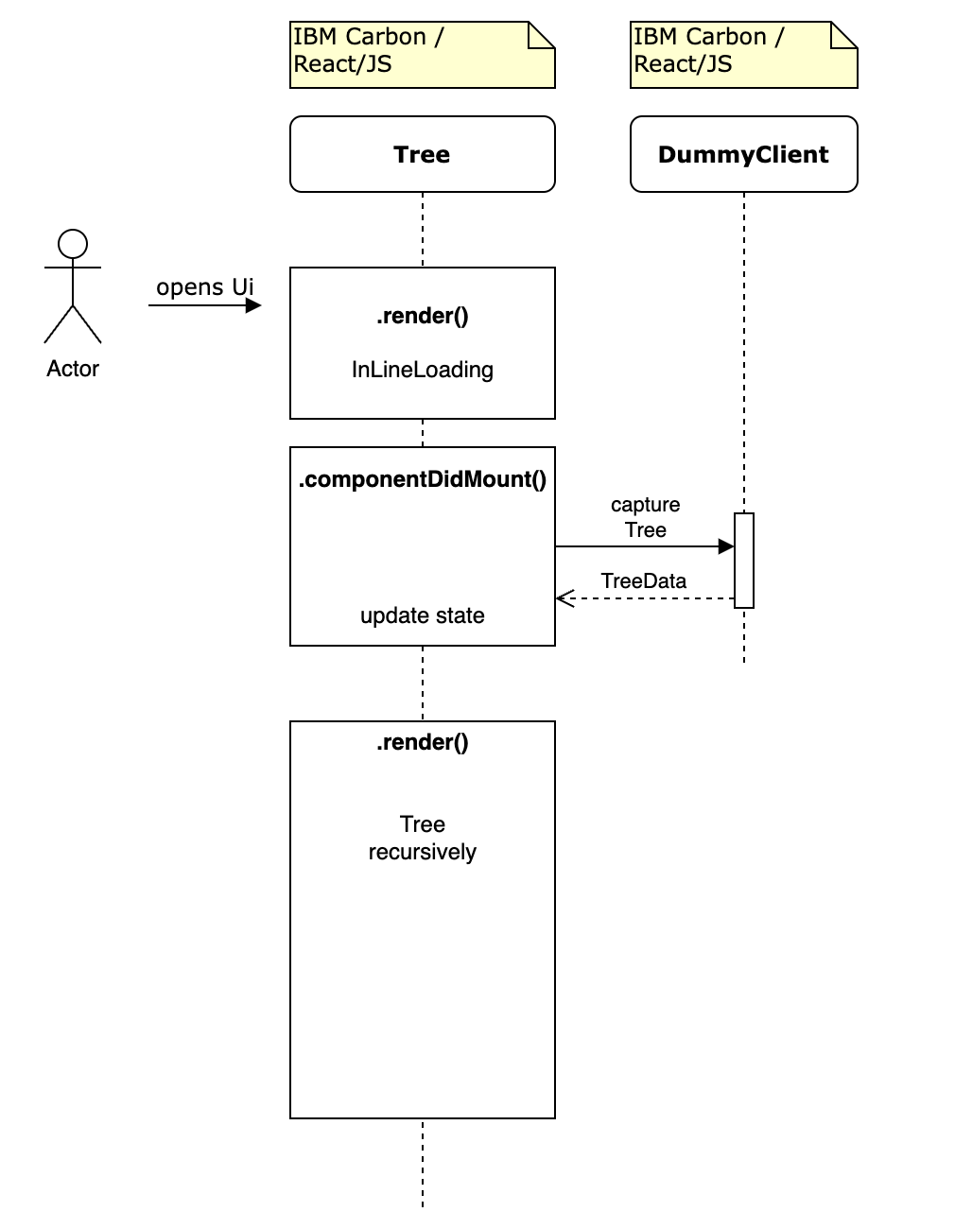
Sequence Diagram

Slide 3
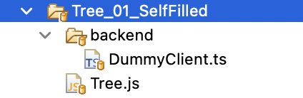
Client-sided Sources
Notes:
Let’s have a look at these sources

